Slide 1

Animal – Bird
Species – Carrion Crow
Order – Passerine
Behaviour – Solitary, noisy
Diet – Insects, seeds, fruit, grain

Slide 2
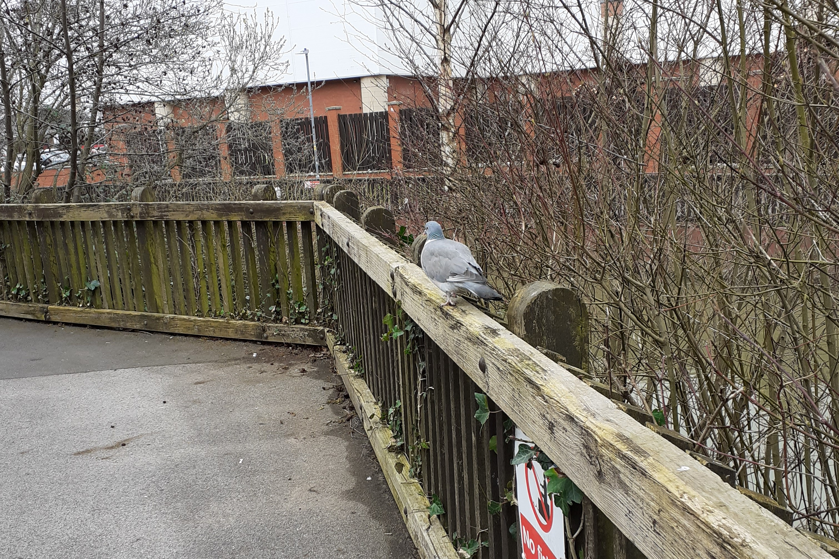
FAUNA ENABLED
FLORA DISABLED
Animal – Bird
Species – Domestic Pigeon
Order – Columbiformes Behaviour – Nest in flocks, nervous around humans
Diet – Human scraps, seeds, insects

Slide 3
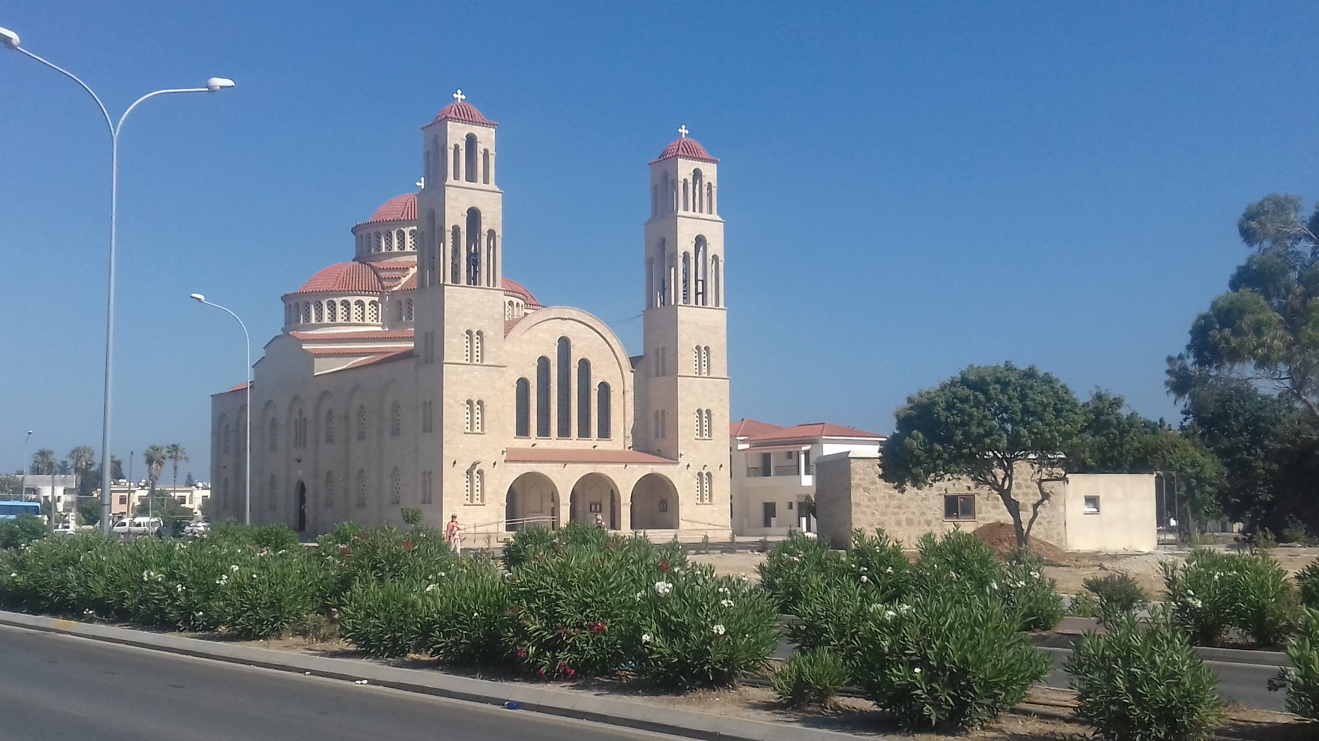
RECORDING: ON
11:35

Slide 4
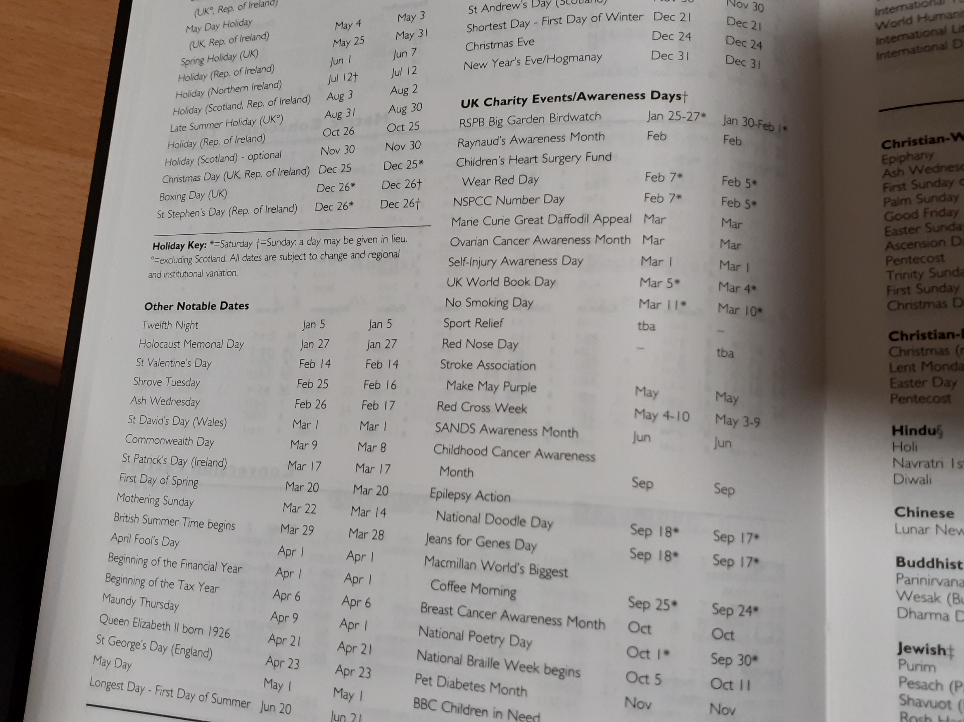

READING: ON

